Slide 1

Improving Integration between Bahmni ERM and Odoo
By: Moeketsi Ntaule <insert student number >
LehlohonoloMatsikane Moeling 201902032
Supivisor: <insert ntate mphatsi real name and title>

Slide 2
Contents of this template
You can delete this slide when you’re done editing the presentation
Fonts | To view this template correctly in PowerPoint, download and install the fonts we used
Used and alternative resources | An assortment of graphic resources that are suitable for use in this presentation
Thanks slide | You must keep it so that proper credits for our design are given
Colors | All the colors used in this presentation
Icons and infographic resources | These can be used in the template, and their size and color can be edited
Editable presentation theme | You can edit the master slides easily. For more info, click here
For more info: Slidesgo | Blog | FAQs
You can visit our sister projects: Freepik | Flaticon | Storyset | Wepik | Videvo

Slide 3
Table of contents
01
04
02
05
03
06
overview
solutions
background
methodology
scope
Conclusion

Slide 4
Resources
Human
resources
Financial resources
Physical resources
The project team is responsible for the successful execution of the project. Our team is composed of experienced professionals with the necessary skills and expertise to complete the project on time and
within budget
Our project budget is $100,000. This budget includes all expenses associated with the project, including salaries and equipment. We have allocated these resources to ensure that we will be able to complete the project on time and within budget
Our project requires a number of specialized pieces of equipment. We will be using [insert equipment and their functions]. All equipment is in good working condition and has been tested and calibrated prior to use

Slide 5

01
Overview

Slide 6
Objectives
The goal
Our aim
Goals inside a company are usually specific and measurable, with clearly defined deadlines and outcomes. The company’s goals help focus the actions of the organization and ensure resources are used effectively
An aim in a corporate context is a goal or desired result that the organization seeks to achieve. The aim should be clear and achievable, and often serves as the basis for further planning actions inside the organization

Slide 7

01
Background

Slide 8



Open source HIS
Components
Brahmin is an open source and free to use Hospital Information system (HIS)
One of the 23 digital public goods recognized projects
Implemented in more than 500 hospital across 50 courtiers
Lesotho implementation in work
Bahmni combines three open source products
OpenMRS Distribution: For electronic medical recording
OpenERP: For Hospital Operations
OpenELIS: Lab information management system
Feature List

Slide 9

Bahmni – Focuses on all aspects of patient care

Slide 10
Odooo
Sources of funding
Personnel costs
Funding for a company can come from personal savings or investments, bank loans and other loan options, venture capital and angel investors, grants, competitions or programs, crowdfunding…
Personnel costs refer to the expenses incurred in hiring, training and retaining staff for a company. This can include salaries, bonuses, benefits and other payroll-related costs
Equipment and materials
Travel and miscellaneous
Equipment and materials costs refer to all the expenses related to the purchasing, maintenance and upkeep of any physical items used in production or other business processes inside the company
Travel and miscellaneous costs refer to expenses related to any travel-related activities, such as conferences, trainings or business trips. It may also include office supplies, communications services, licenses and other miscellaneous expenses

Slide 11
Integration and Interoperability
How does Bahmni provide integration over all services?
Bahmni is modular
New components in and old ones removed
Bahmni can be enhanced at multiple levels
Custom distribution of OpenMRS
Adding new definitions for different services
Adding new components based on standards
Atom Feeds over HTTP
All Bahmni components communicate with each other using Atom feeds
Each component publishes a log of relevant events happening
Other components listen to this feed using libraries
Only authorized clients can listen to feeds
Rich data interface over standard API and push and pull data updates directly

Slide 12

03
Problem And Scope

Slide 13
Odooo
Sources of funding
Personnel costs
Funding for a company can come from personal savings or investments, bank loans and other loan options, venture capital and angel investors, grants, competitions or programs, crowdfunding…
Personnel costs refer to the expenses incurred in hiring, training and retaining staff for a company. This can include salaries, bonuses, benefits and other payroll-related costs
Equipment and materials
Travel and miscellaneous
Equipment and materials costs refer to all the expenses related to the purchasing, maintenance and upkeep of any physical items used in production or other business processes inside the company
Travel and miscellaneous costs refer to expenses related to any travel-related activities, such as conferences, trainings or business trips. It may also include office supplies, communications services, licenses and other miscellaneous expenses

Slide 14





Scope Statement
Scope statement
The project aims to enhance the existing CDC (Change Data Capture) integration within the Bahmni ERM (Electronic Medical Record) and Odoo systems by transitioning from the current Atom-feed-based mechanism to a more robust Messaging-Oriented Middleware (MOM) solution. The objective is to improve real-time data synchronization, error handling, and security measures.

Slide 15
Objectives
Assesment
MOM Selection
Create Data consumer modules
Conduct thorough assessment of current Atom-Feed-based CDC integration to identify strengths, weaknesses and areas of improvement
Select appropriate MOM considering performance, reliability , and compatibility with Bahmni ERM and Odoo
Create a data consumer module in Odoo that will consume data events and implement data transformation logic
MOM integration
Create data producer modules
Data migration strategy
Develop a data producer within Bahmni ERM to capture data events and publish them to MOM
Implement selected MOM based solution ensuring realtime syncronization, error handling and data security.
Create detailed strategy to outline the process of transitioning from Atom fee to chosen MOM solution

Slide 16
Requirements
Functional Requirements
Non-Fuctional Requirements
Data producer on Bahmni
Data consumer on Odoo
Real-time Syncronization
Error handling and fault tolerance
MOM system
Reliability
Scalability
fault tolerant
Compatibility
resource efficiency
throughput

Slide 17
01
Methodology

Slide 18

Iterative Incremental development (IIID) Model
Focus on dividing the project into parts such as
Data consumer on Odoo
Data producer on OpemMRS
Message middleware
Iterations repeated until the product reaches a desired level of functionality such messages reliably being sent from Bahmni to Oddo
Enhancements and other features added each iteration such as scalability to other services.

Slide 19
01
Deliverables and time frame

Slide 20

Project Deliverables
Data Producer Module
Message-oriented Middleware
Data Consumer Module
A module in Bahmni ERM to detect relevant data changes in Bahmni database and publish them to the Message Middleware.
Middleware that connects the data producer with the data consumer.
Software for seamless exchange of data between consumer and receiver
Handle message topics and queues
Simulate data synchronizatioon
Odoo component that receives MOM messages and consume data events.
Implement data updates in response to receive messages.

Slide 21
Project activities
Activity | Start date | End date | Resource | Cost | Revenue
Market research | 1/1/20XX | 1/15/20XX | Market research firm | $20,000
Product development | 1/16/20XX | 6/30/20XX | R&D team | $200,000
Beta testing | 7/1/20XX | 8/15/20XX | Beta testers | $10,000
Marketing campaign | 1/1/20XX | 1/15/20XX | Advertising agency | $100,000
Product launch | 1/16/20XX | 6/30/20XX | Sales team | $50,000 | $500,000
Post-launch support | 7/1/20XX | 8/15/20XX | Support team | $50,000 | $800,000

Slide 22
01
solutions

Slide 23
Project roadmap
Initiative | Objective | Jan | Feb | Mar | Apr | May | Jun | Jul | Aug | Sep | Oct | Nov | Dec
Market research | Increase brand awareness by 30% within the first year
Product development | Achieve a customer satisfaction rate of 90%
Marketing campaign | Increase revenue by 20% within the first year
Product launch | Achieve a customer satisfaction rate of 90% within the first year
Expansion | Reduce costs by 15% within the first year by expanding the product
Partnership | Reach profitability within 18 months of launch

Slide 24
Solution options
Solution 1
Solution 2
Solution 3
Having explored different options we have opted to explore this stuff baaam listing
Outsourcing specific business functions (such as accounting or IT) to a third-party provider to reduce costs and increase time efficiency
Launching an e-commerce platform to expand the reach of the business and increase online sales
Solution 4
Solution 5
Solution 6
Developing a new product or service to diversify the business and also increase revenue streams
Implementing a cost-saving initiative, such as energy-efficient practices or process automation, to reduce expenses long-term
Establishing strategic partnerships with other businesses to gain access to new markets or
innovative technologies

Slide 25
Project timeline
Conduct market research and analyze the target audience to identify opportunities
Create the product or service by defining features, design, and functionality
Test the product with a group of users to receive feedback and improve the product
Execute a marketing campaign to promote the product to the target audience
Release the product or service to the market with a comprehensive launch plan
Provide customer support to ensure customer satisfaction
Explore opportunities for growth and expansion of the product or service
Continuously improve the product based on customer feedback and market trends

Slide 26
10 million
First-year revenue of the project

Slide 27
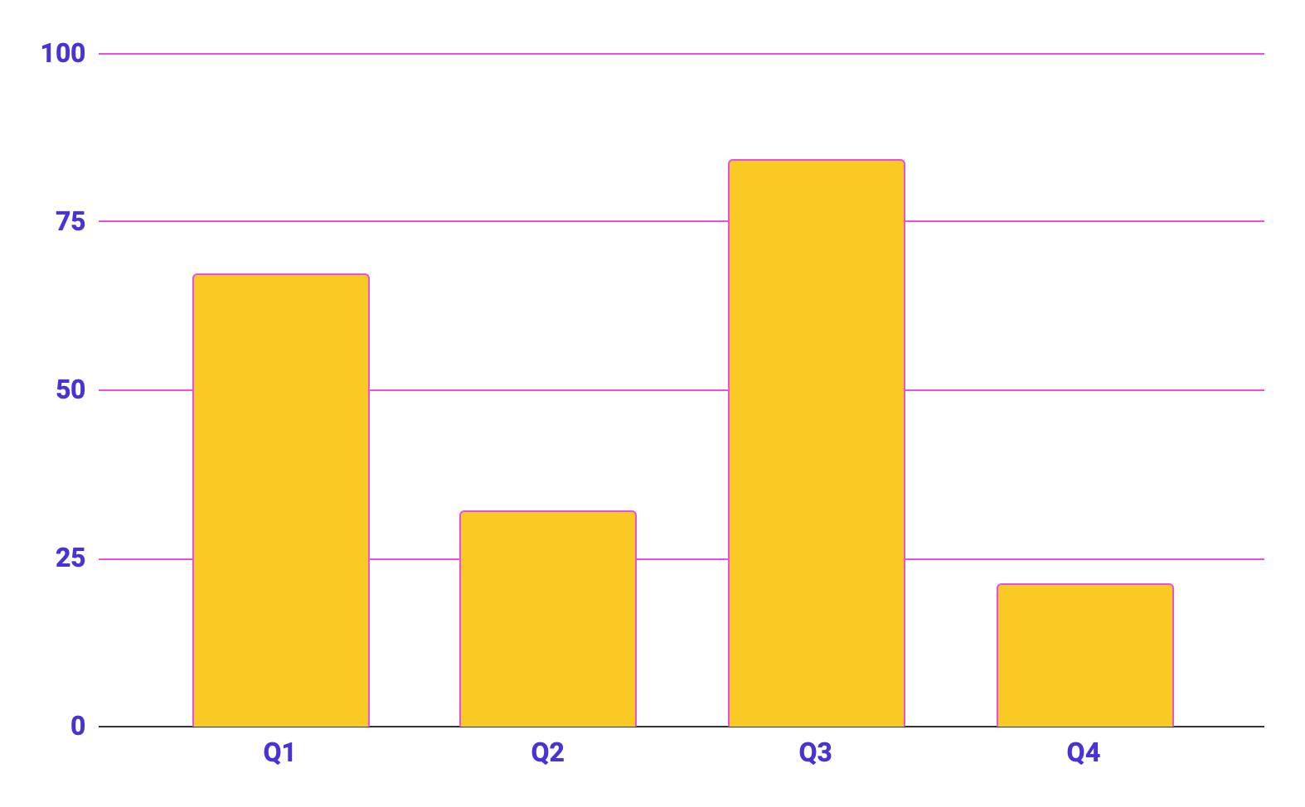
Project data
Benefits of using graphs
Graphs in project proposals offer visual organization, enabling clear presentation of information in a structured format. They enhance the visual appeal, facilitate data comparison and improve overall clarity and professionalism of your project proposal
Follow the link in the graph to modify its data and then paste the new one here. For more info, click here

Slide 28




conclusion
A photo showcase can be a useful addition to a business project proposal as it can help to visually communicate the concept or idea being proposed

Slide 29
Thanks!
Do you have any questions?
youremail@freepik.com
+34 654 321 432
yourwebsite.com
Please keep this slide for attribution

Slide 30
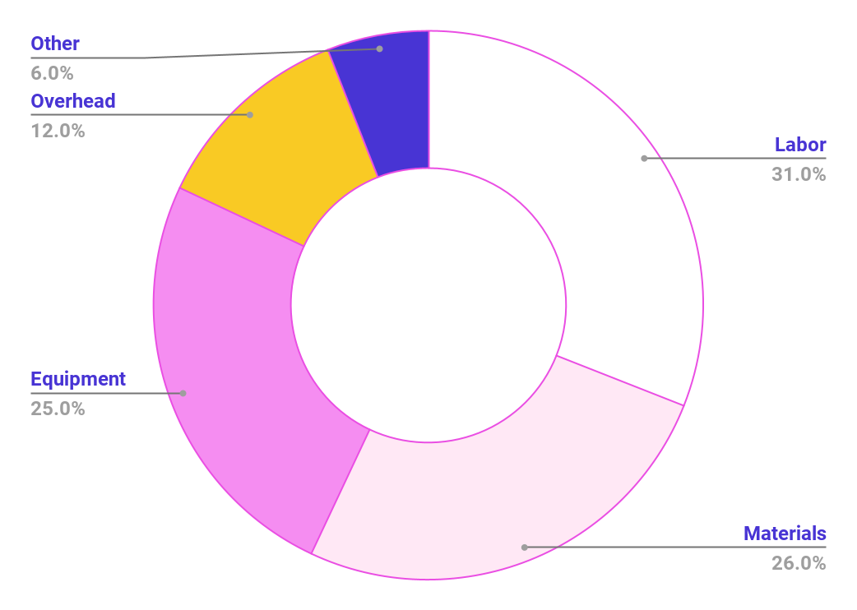
Project expenses
Labor
Materials
Equipment
Overhead
Other
Follow the link in the graph to modify its data and then paste the new one here. For more info, click here

Slide 31
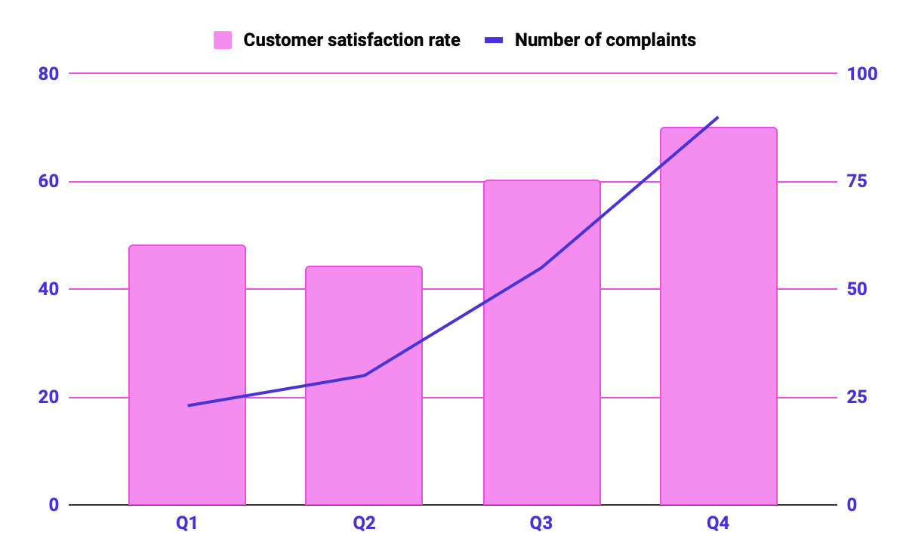
KPI dashboard
120 u/day
2h
Resource | Utilization rate | Cost per unit
Labor | 85% | $50
Equipment | 70% | $100
Materials | 95% | $20
Rent | 90% | $1,000
Energy | 80% | $80
Software licenses | 80% | $200
Advertising | 60% | $500
Output per worker
Time to complete a task
Follow the link in the graph to modify its data and then paste the new one here. For more info, click here

Slide 32
Icon pack

Slide 33
Alternative resources
Here’s an assortment of alternative resources whose style fits the one of this template:
Vectors
Health and fitness instagram stories collection with photo
Instagram sale stories collection with photo

Slide 34
Resources
Did you like the resources in this template? Get them at these websites:
Vectors
Gradient instagram sale posts collection
Gradient instagram sale stories collection
Photos
Modern and equipped computer lab
Website hosting concept with hands holding tablet
Side view women at office
Colleagues working together medium shot
Employees working together front view
Modern and equipped computer lab
Icons
Icon Pack: Cloud Computing | Lineal

